Slide 1
TEXT CLASSIFICATION USING NAÏVE BAYES

Slide 2
PROBLEM STATEMENT
Imagine, you own a large e-commerce website which shows relevant products to a user based on his/her search and preferences.
Every time you want to add new products you have to read their descriptions and manually assign a category to them.
This procedure can cost you too much time and money.
If you develop an automatic text classifier, you can easily add many new products and tag them automatically without actually reading the descriptions.

Slide 3
APPROACH TO A SOLUTION
For several decades now, document classification in the form of text classification systems have been widely implemented in numerous applications such as spam filtering, e-mails categorizing, directory maintenance, and ontology mapping.
An increasing number of statistical and computational approaches have been developed for document classification, including k-nearest-neighbor (k-NN) classification, naive Bayes classification, support vector machines (SVMs), maximum entropy, decision tree induction, rule induction, and artificial neural networks.
Creating a classifier to link search texts to the item categories for a better user experience.

Slide 4

APPROACH USING NAIVE BAYES
In the context of document classification, the Bayes theorem uses the fact that the probability of a particular document being annotated to a particular category, given that the document contains certain words in it, is equal to the probability of finding those certain words in that particular category, times the probability that any document is annotated to that category, divided by the probability of finding those words in any document,

Slide 5
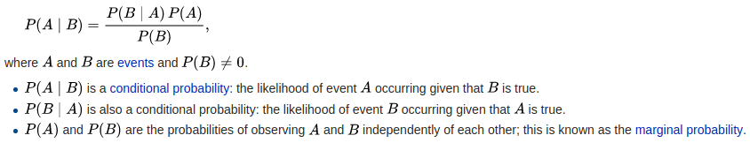
Bayes Theorem defines probability of an event based on the prior knowledge of factors that might be related to an event.
Mathematical Statement of Bayes Theorem is as follows :

Slide 6
Now, basically for a data point xi, we have to predict the class that the current output Y belongs to. Assume, there are total 'j' number of classes for output. Then, P(y=c1|x=xi) ---> tells us that for given input xi what is the probability that y is c1. P(y=c2|x=xi) ---> tells us that for given input xi what is the probability that y is c2. and so on till cj.
Out of all these probabilities calculations, y belongs to that particular class which has maximum probability.
We will be using Bayes theorem to doing these probability calculations.

Slide 7
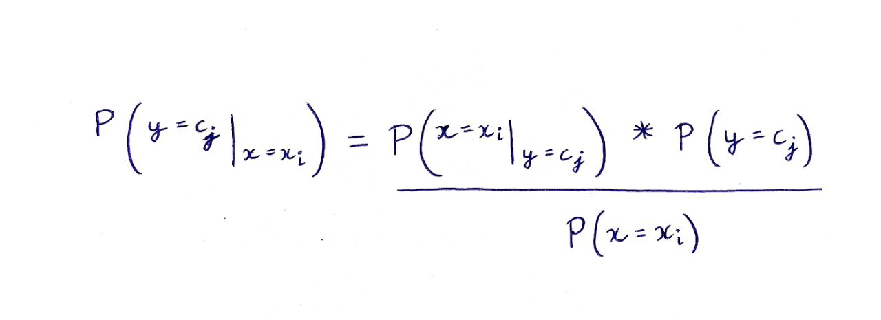
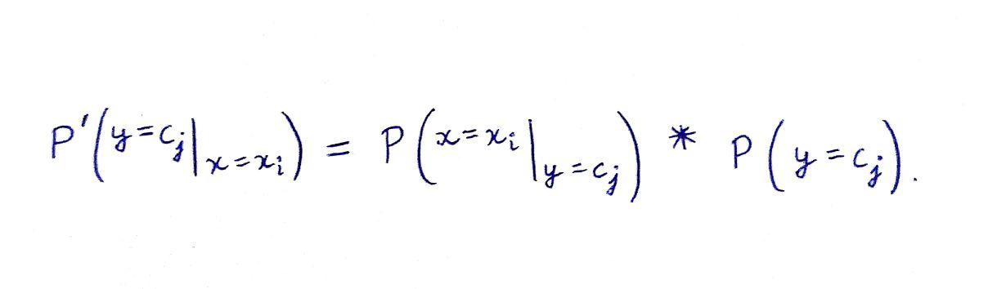
This gives us the probability that the output belongs to jth class for the current values of data point (xi).
Since for all the classes 1,2,...,j the denominator will have the same value, so we can ignore this while doing comparison. Hence, we obtain the given formula to calculate probabilities.

Slide 8
NAIVE ASSUMPTION
The estimate for probability P(y=cj), can be done directly from the number of training points.
Suppose there are 100 training points and 3 output classes, 10 belong to class c1, 30 belong to class C2 and remaining 60 belong to class C3.
The estimate values of class probabilities will be: P(y = C1) = 10/100 = 0.1 P(y = C2) = 30/100 = 0.3 P(y = C3) = 60/100 = 0.6
To make the probability estimate for P(x=xi|y=cj), naive bayes classification algorithm assumes all the features to be independent. So, we can calculate this by individually multiplying the probabilities obtained for all these features (assuming features to be independent), for the output of jth class.

Slide 9
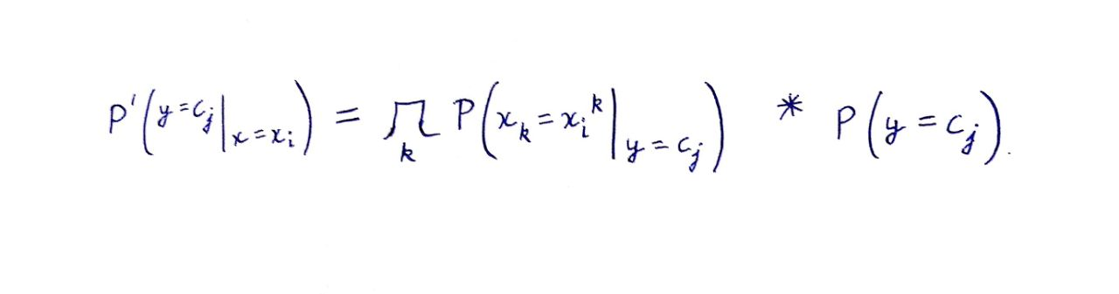
P(x=xi|y=cj) = P(x=xi¹|y=cj) P(x=xi²|y=cj) .... P(x=xi^{n}|y=cj)
here, xi¹ denotes the value of 1st feature of ith data point and x=xi^{n} denotes the value nth feature of the ith data point.
After taking up the naive assumption, we can easily calculate the individual probabilities and then by simply multiplying the result calculate the final probability P'.

